Slide 1


Winter School Special Lecture
Urban Patterns: Spatio-temporal analysis
Assessing patterns of public disturbance acts using crowdsourced data
Case of Stockholm, Sweden
Omkar Parishwad
Urban Mobility Group
Department of Architecture and Civil Engineering

Slide 2
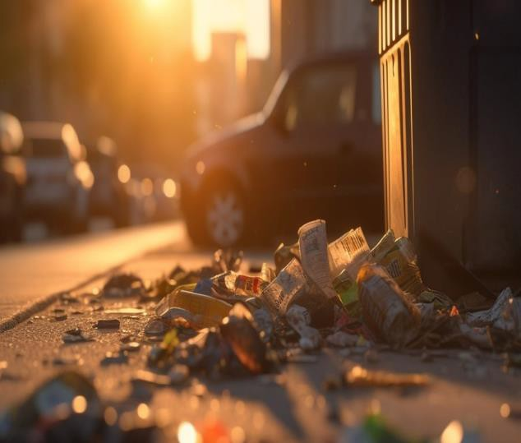
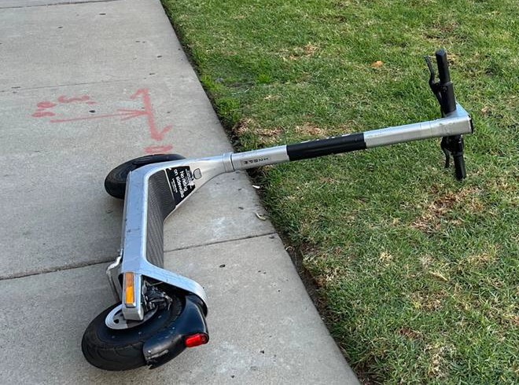
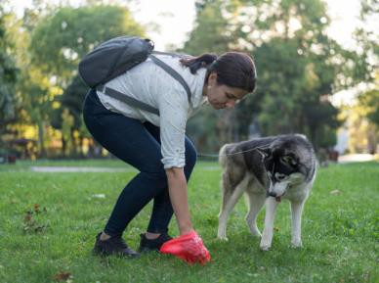
Acts of public disturbance
Littering
Abandoned vehicles
Situational conditions of misbehaviour
What, Who, Where, When
Littering
Graffiti & physical damage (vandalism)
Abandoned cars
Poor bike parking
Urination and defecation
Defecation, urination
Private pictures, Pixabay & iStock

Slide 3
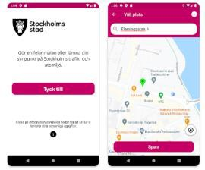














Crowdsourced Records
Tyck till App
Littering
Detection
Reporting
Mapping
Analyzing

Slide 4
The pandemic changed our movement patterns..
Aim of the study is to investigate the level and the distribution of public disturbance acts in Stockholm before and after the recommended stay-at-home measures of the COVID-19 pandemic.
Did it change?
When/where change the most? Land use?
Crowdsourced data
Activities in parks and green areas increased, around basic services, small local squares, and close to outdoor serving locations (Legeby et al., 2022)
Reference: https://github.com/parishwadomkar/UrbanPatterns/blob/main/Google%20and%20apple%20Mobility%20data.ipynb

Slide 5
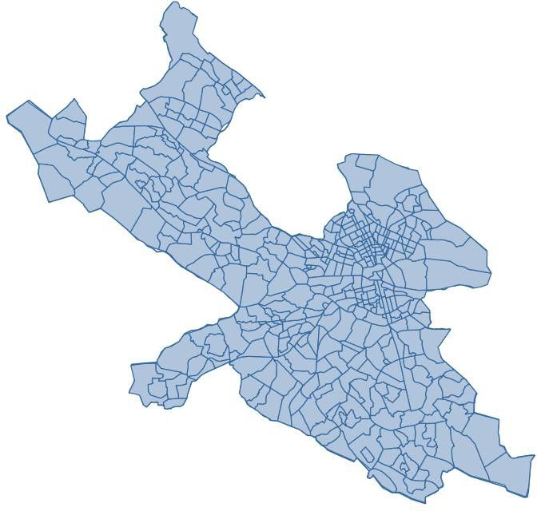
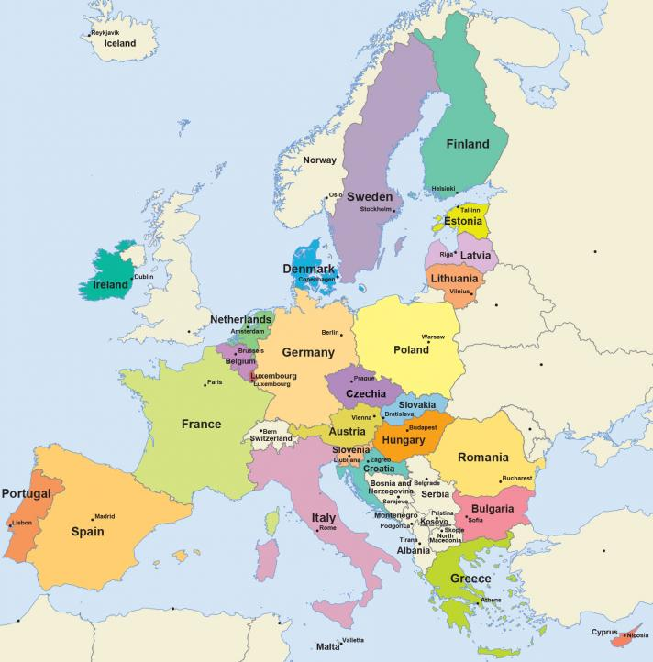
Study area
Sweden
Stockholm

Slide 6
Data and Methods
Data covered a total period of about 30 months (95,262)
5 types (Urine/defecation, littering, graffiti and physical damage, abandoned cars, poor bike/scooter parking)
Police recorded statistics of littering & vandalism
Before Pandemic (BP) & Post-Pandemic (PP)
Temporal (time-series) – ARIMA models
Spatial Models
Heatmaps (Kernel density estimates)
Poisson-Gamma-CAR regression models
(Consider other Spatial models for results/interpretations..)

Slide 7
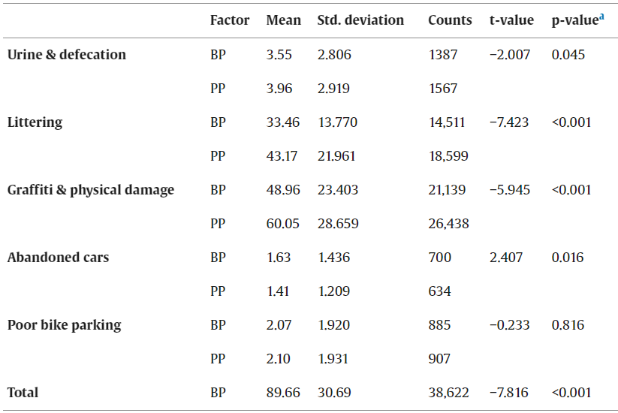
Exploratory data analysis
Before Pandemic data
183725 (45.30% )
Post Pandemic data
221825 (54.70% )

Slide 8
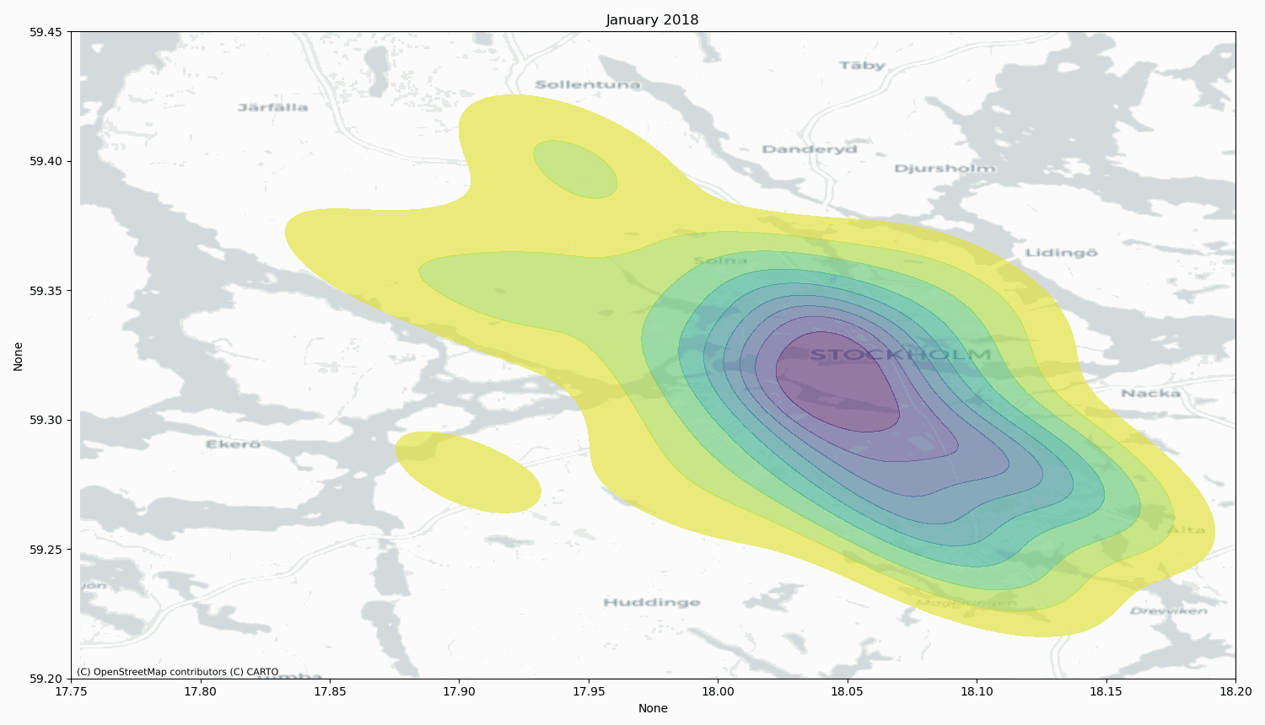
Need for spatio-temporal analysis..
Generating visualization
Heatmaps
Reference: https://github.com/parishwadomkar/UrbanPatterns/blob/main/Visual%20Heatmaps.ipynb

Slide 9
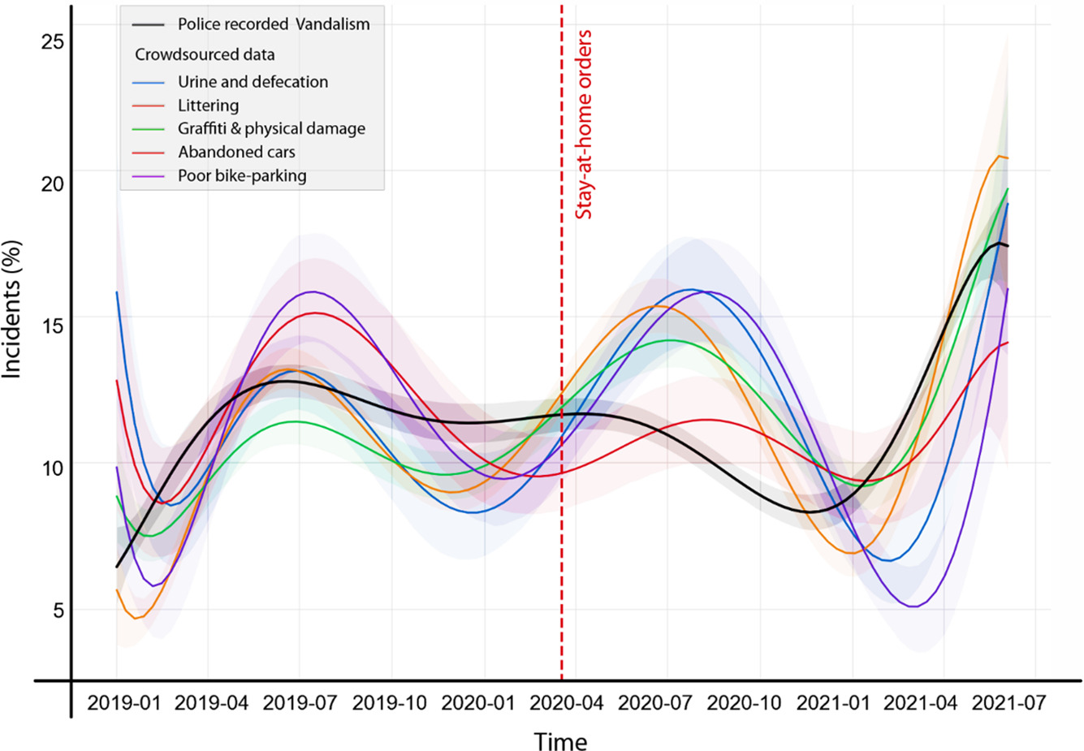
Temporal analysis
Temporal variations in the dataset:
Seasonal Trends
Littering & maintenance: Cleaning; general; building bags; source sorting (FTI); trash bins and containers; green areas and parks; cleaning of streets and parks; litter; park maintenance; lawn moving; obstacles on footpath in parks..

Slide 10
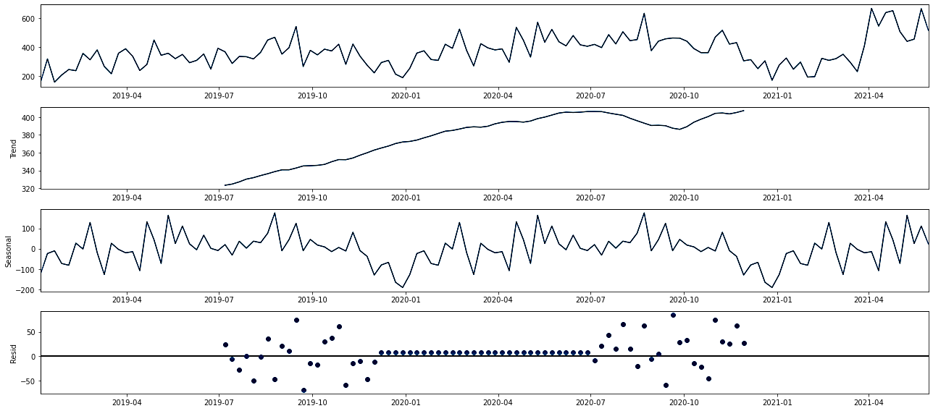
Time Series analysis (SARIMAX)
Seasonal AutoRegressive Integrated Moving Average for an exogenous variable

Slide 11
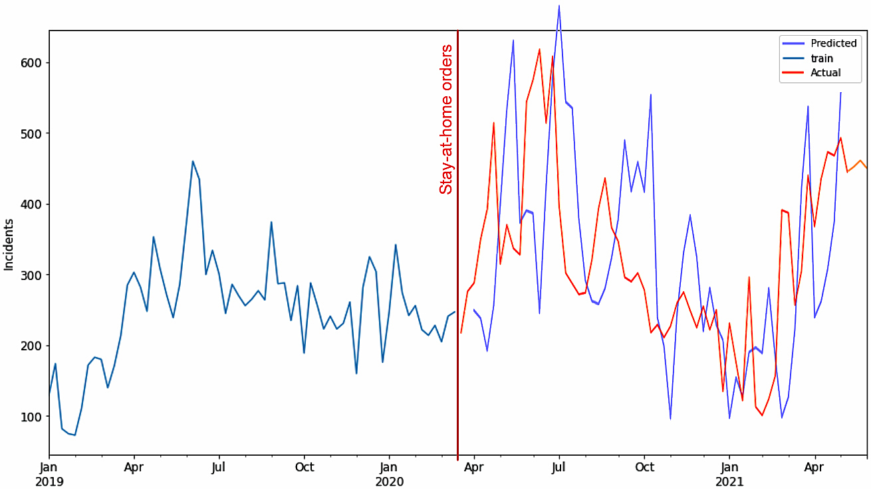
Time Series analysis (SARIMAX)
Seasonal AutoRegressive Integrated Moving Average for an exogenous variable

Slide 12
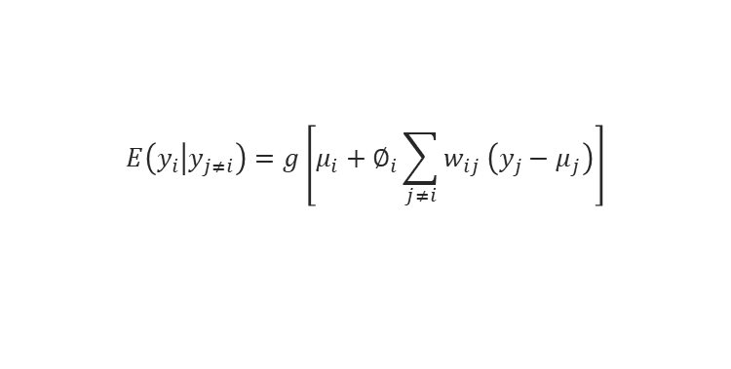
Spatial analysis (Poisson Gamma CAR-MCMC model)
Poisson-Gamma (negative binomial) for an alpha value, as our count variable is normal and certainly not homoscedastic (constant variance), assumptions made by the least squares method. To consider the spatial autocorrelation in the models, the Markov Chain Monte–Carlo (MCMC) was used but with a conditional autoregressive (CAR) adjustment:
$$E\left(y_{i} | y_{j≠i}\right)=g\left[μ_{i}+∅_{i}\sum_{j≠i}{w_{ij}}\left(y_{j}−μ_{j}\right)\right]$$
It uses the 1st-order nearest neighbor distance or contingency weights. The weights we use, on the other hand, are distance weights with distance calculated between zone (Basomrade) centroids. The usual distance weight is a negative exponential:
w_{ij} = e – α d_{ij}

Slide 13
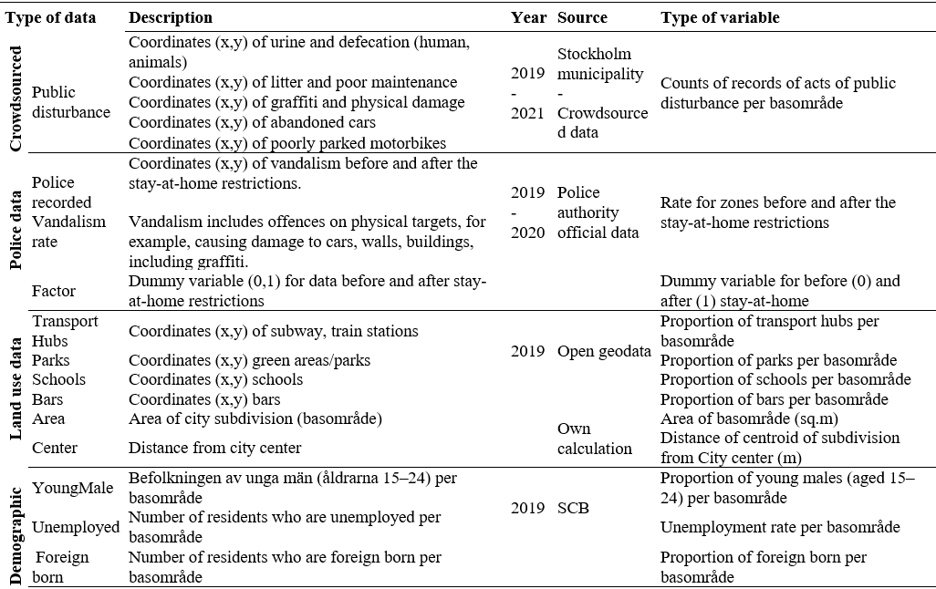
Parameters

Slide 14
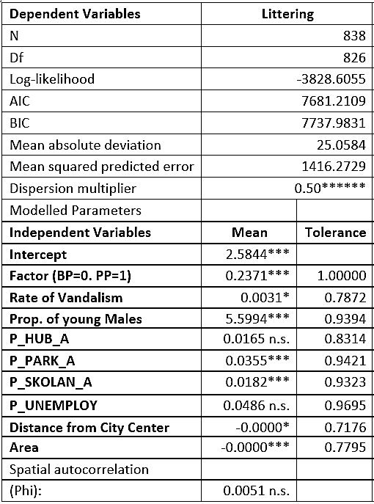
Spatial analysis
RQ1 - Are there significant differences in the number of records before and after the stay-at-home orders for acts of public disturbance?
RQ2 – Controlling for seasonal trends, which are acts of public disturbance that vary the most?
RQ3 – Is there a shift in the geography to all types of acts of public disturbance?
RQ4 – Are parks, transport hubs and schools associated with acts of public disturbance, after controlling for neighborhood characteristics, and how?

Slide 15
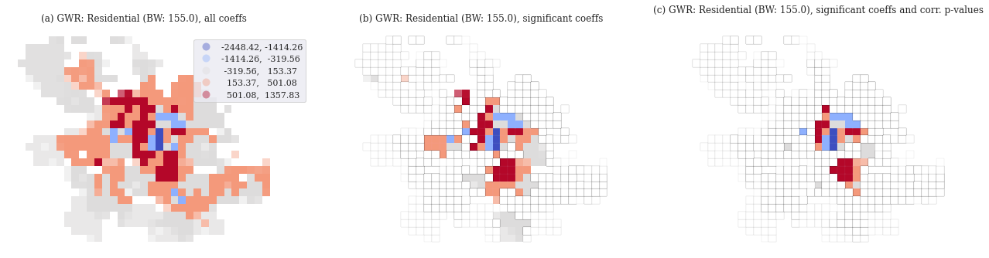
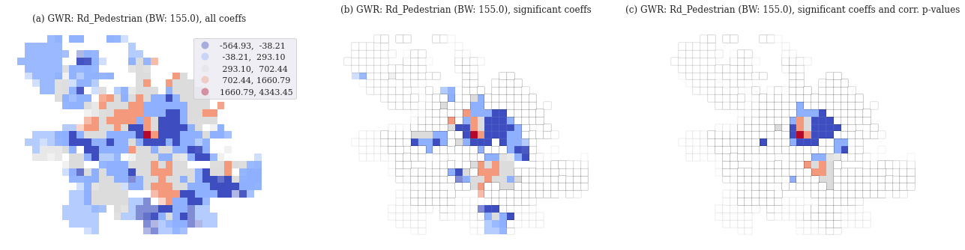
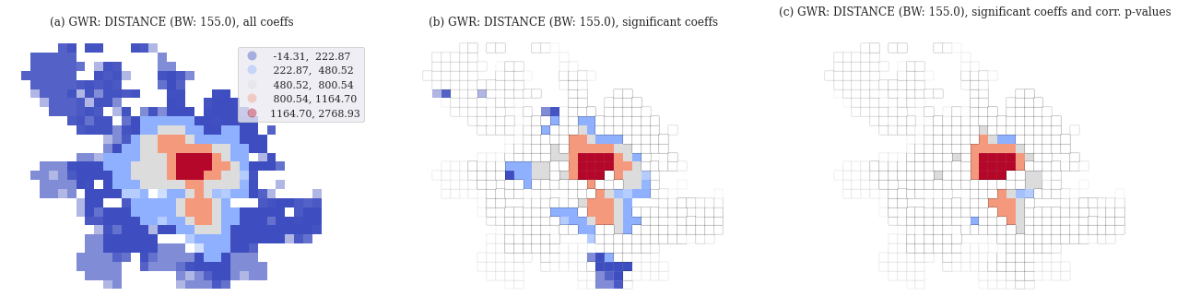
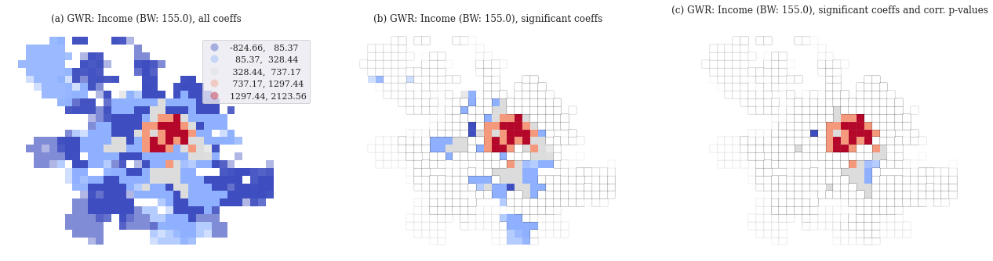
Spatial analysis: coefficients and spatial trends

Slide 16
Other Spatial models: Spatial Random Forest
Spatially evolved Random Forest using bandwidth concept A positive number that may be an integer in the case of an "adaptive kernel" or a real in the case of a "fixed kernel". In the first case, the integer denotes the number of nearest neighbours, whereas in the latter case the real number refers to the bandwidth. (Georganos et al. (2019) Spatial extension of the random forest algorithm with parameter tuning doi:10.1080/10106049.2019.1595177). Reference: https://github.com/parishwadomkar/Usage-analysis-e-scooter/blob/main/SpatialML_Sto.R

Slide 17
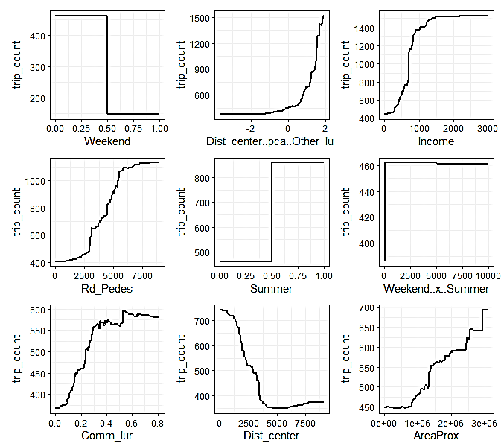
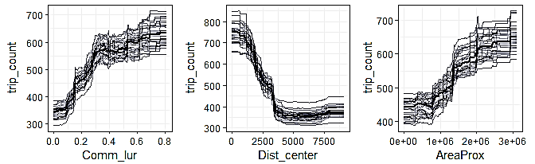
Variable relation
Response curves or
Partial dependence plots (PDP)
These plots help visualize how the predicted outcome changes as a function of one or more independent variables while keeping other variables constant.

Slide 18
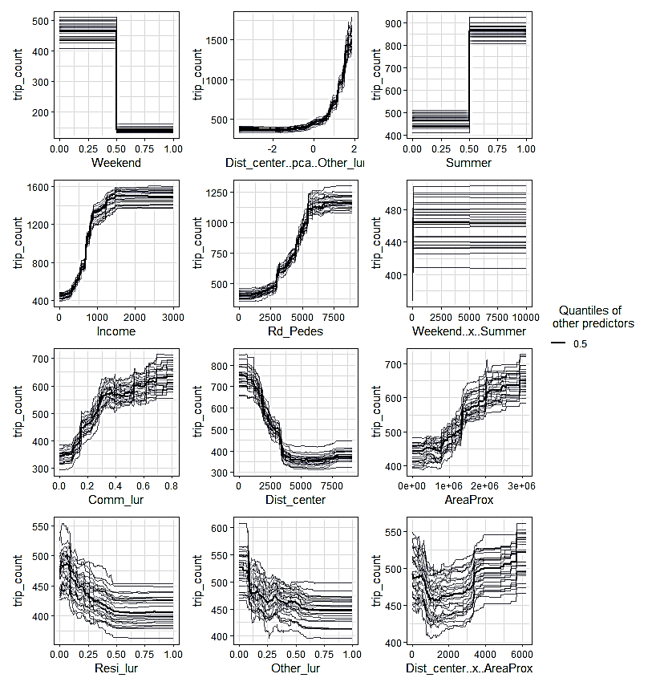
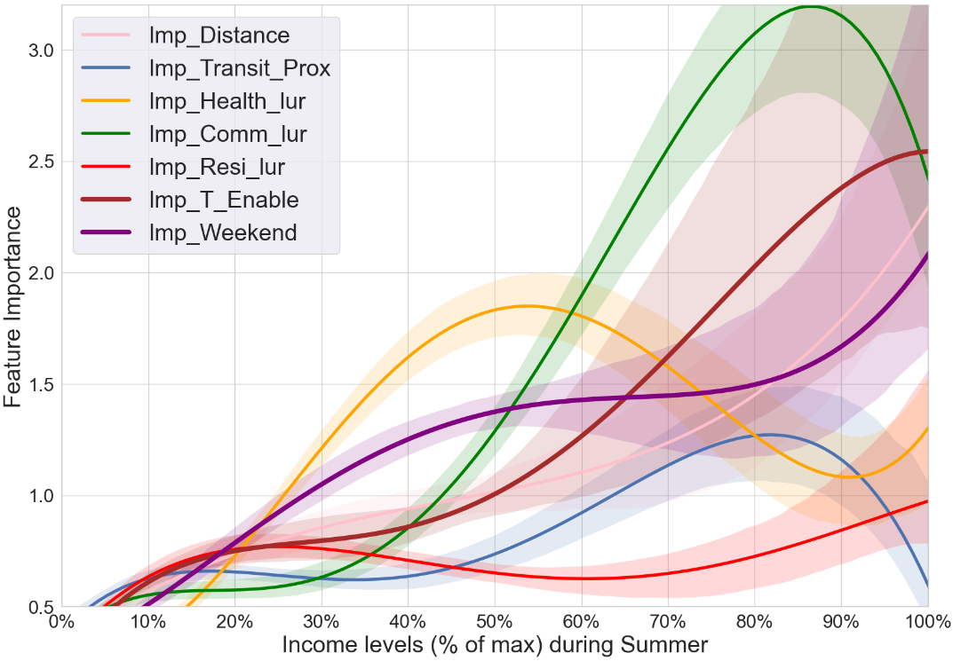
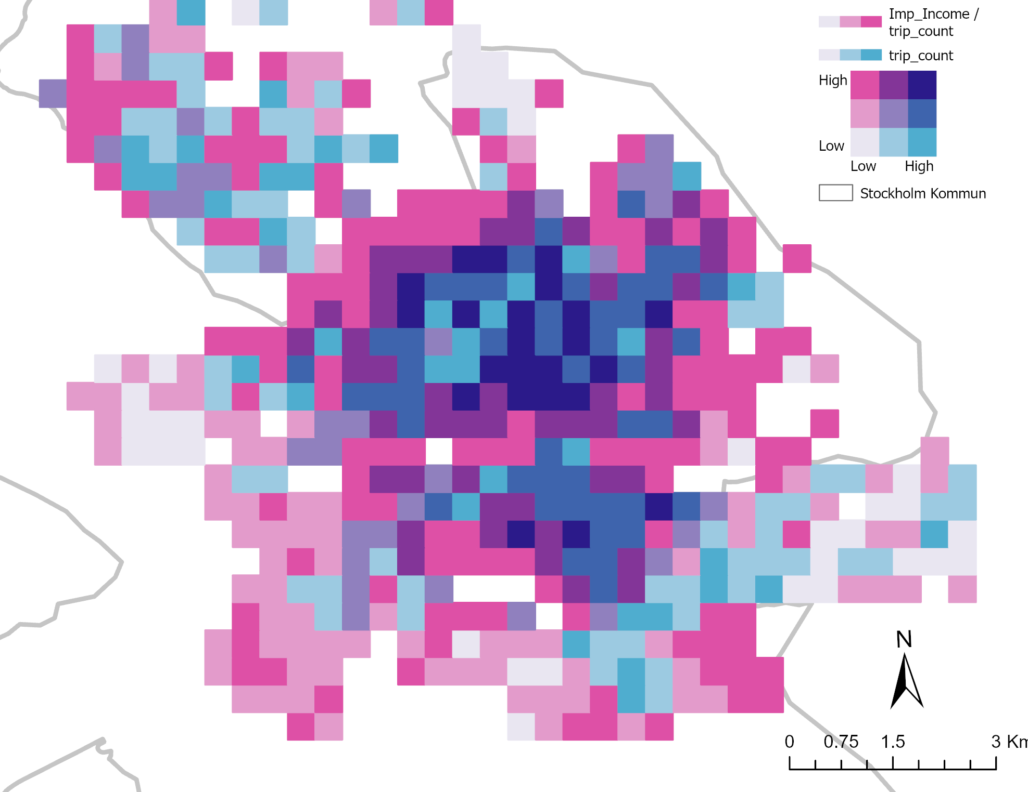
Income levels

Slide 19
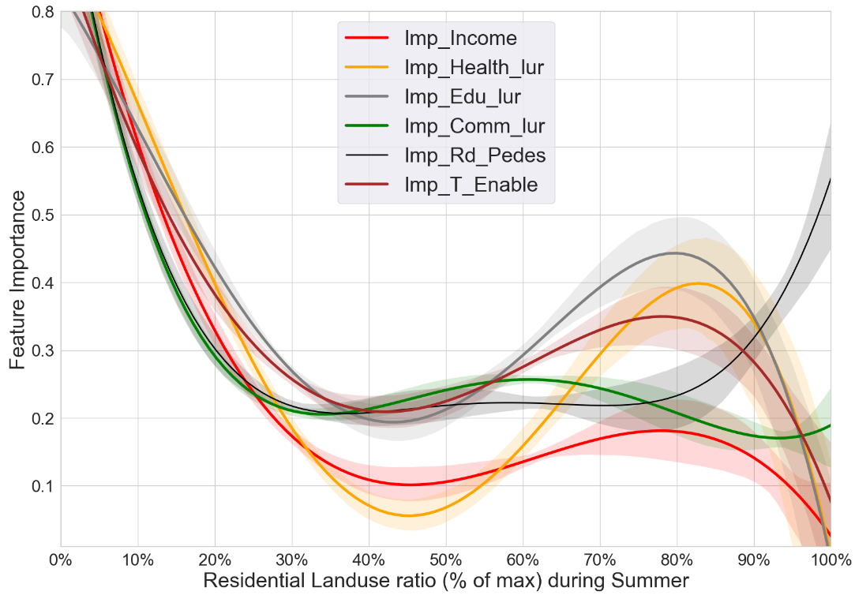
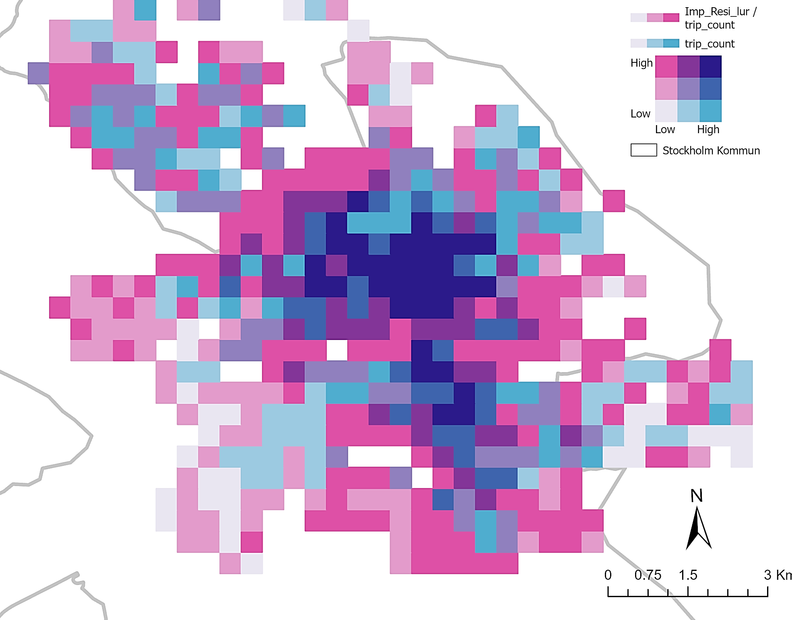
Residential LUR (tdifd)

Slide 20
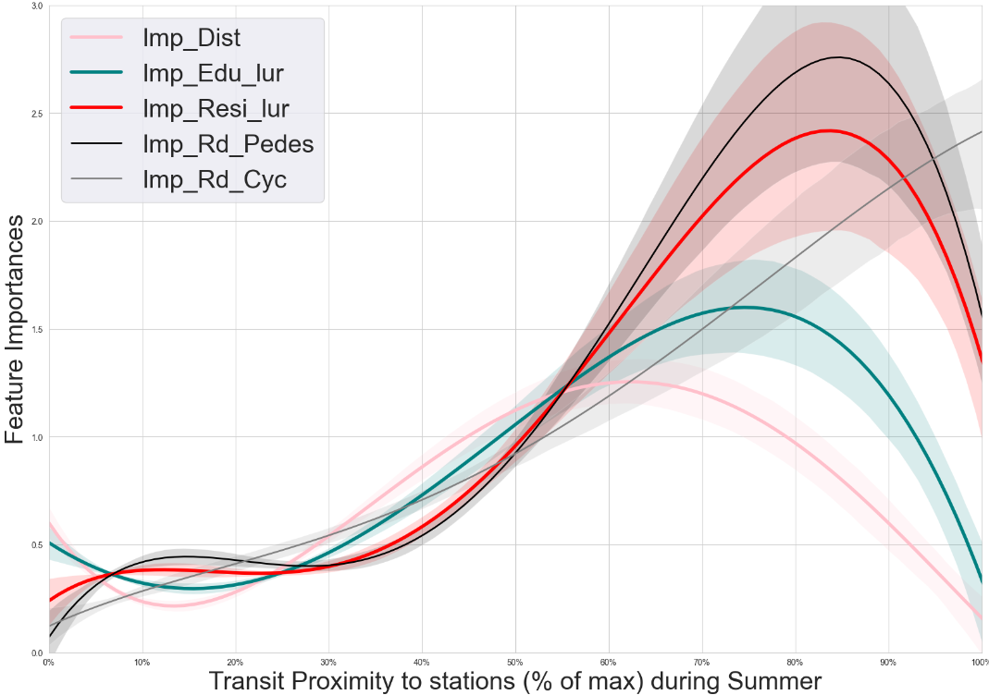
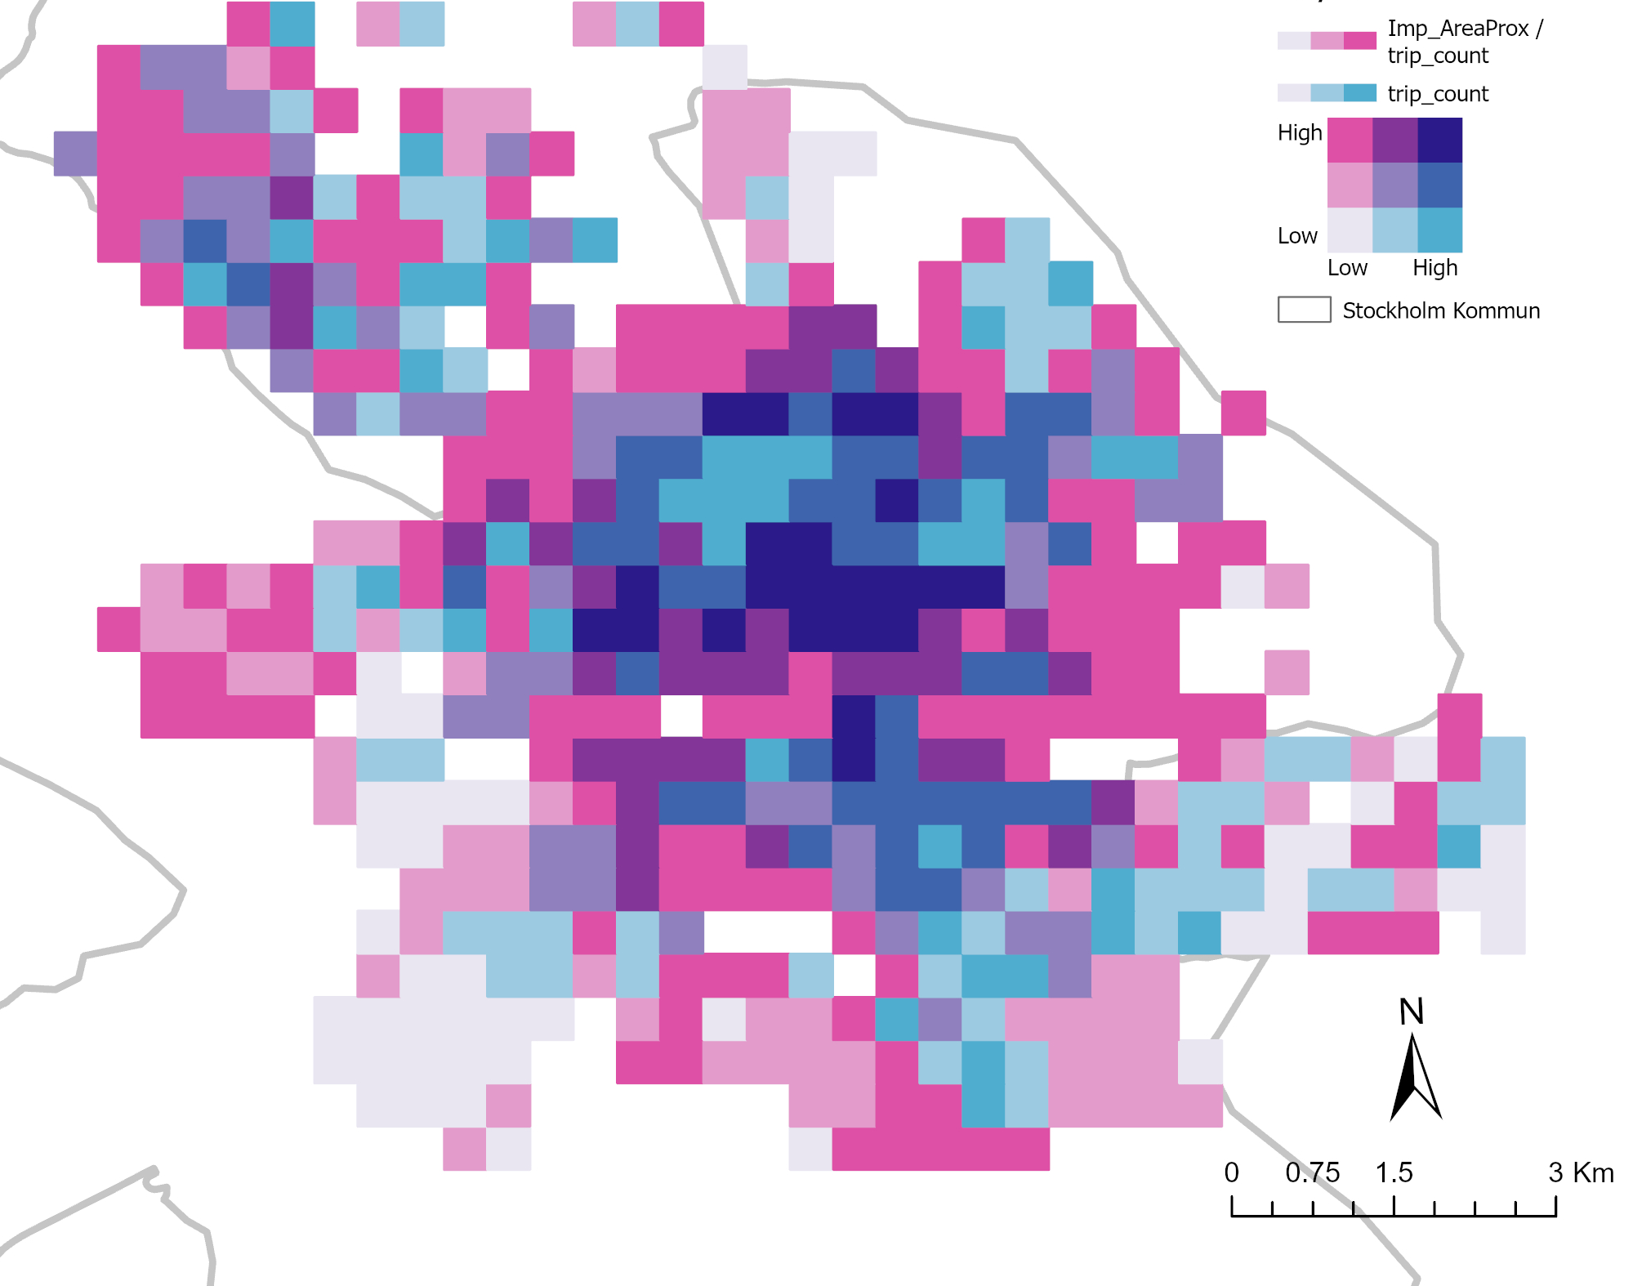
Proximity to transit stations

Slide 21
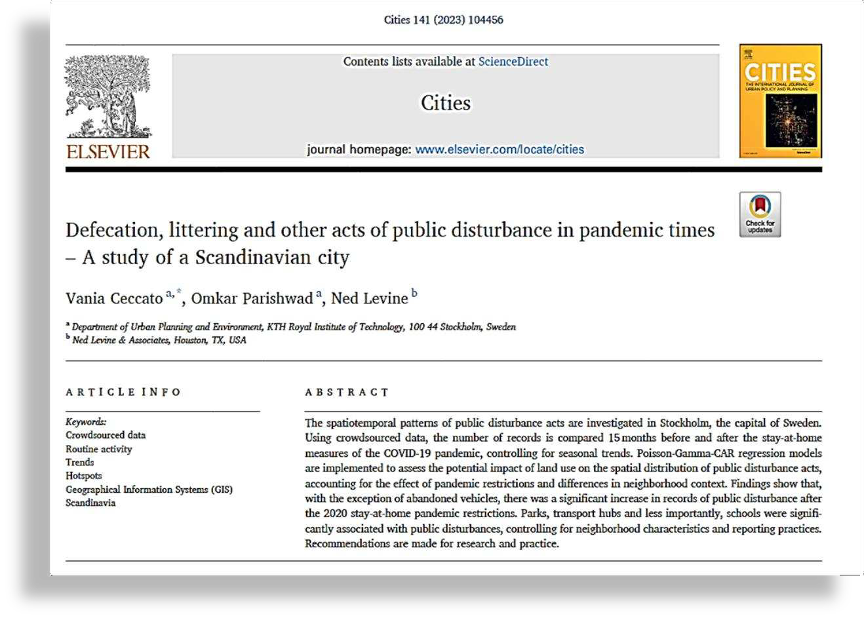


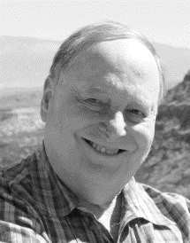
Thanks for listening!
Vania Ceccato
KTH Royal Institute, Sweden
Omkar Omkar Parishwad
Chalmers University, Sweden
omkarp@chalmers.se
Ned Levine
Ned Levine & Associates, USA
https://doi.org/10.1016/j.cities.2023.104456

